Slide 1










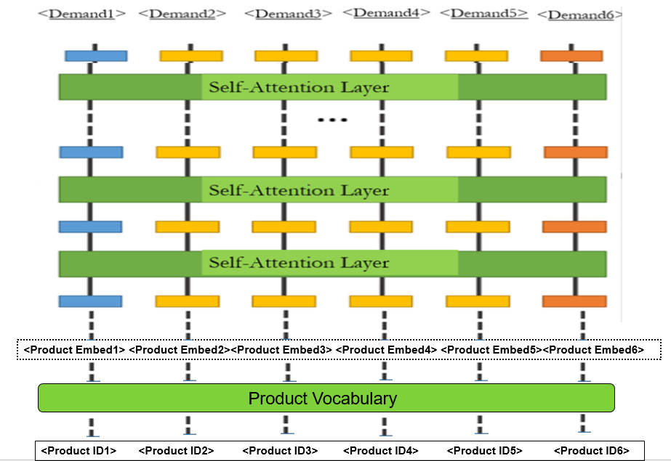

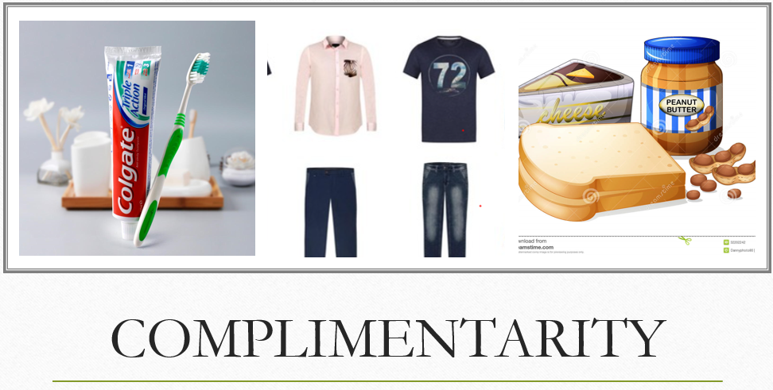
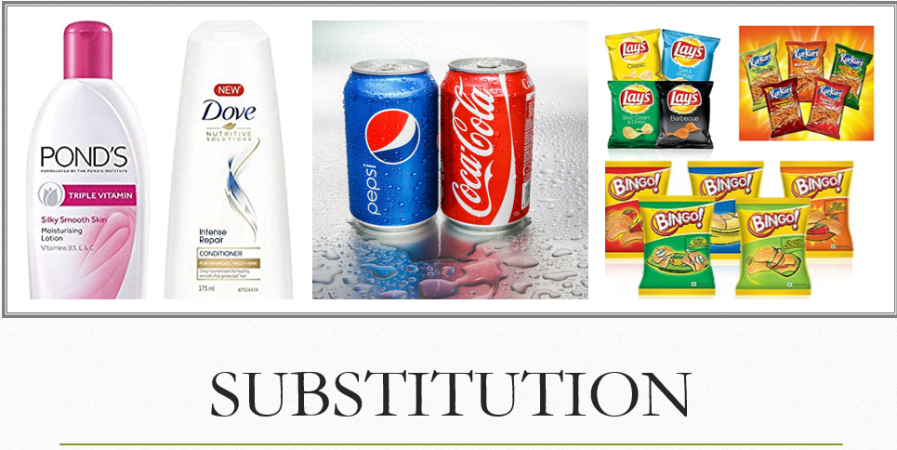
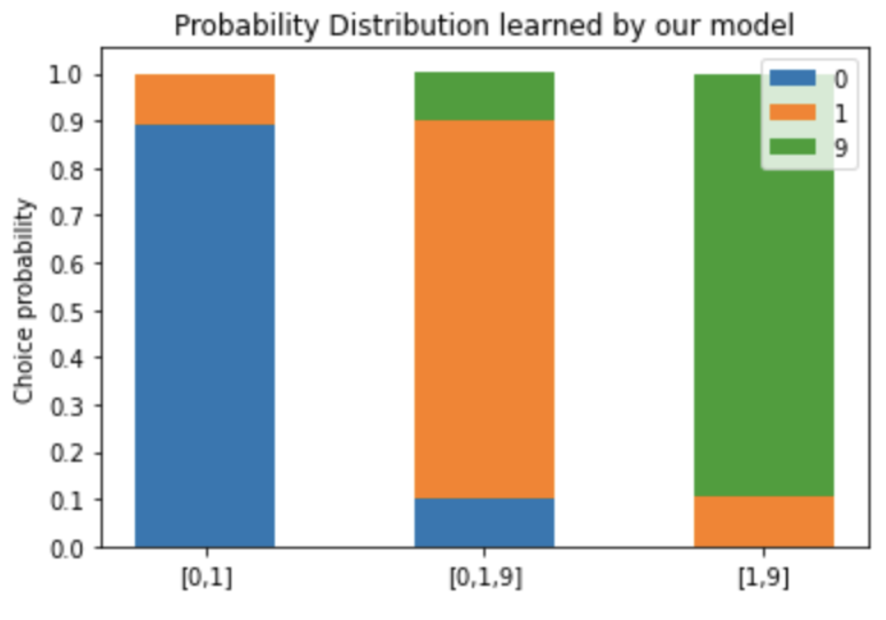
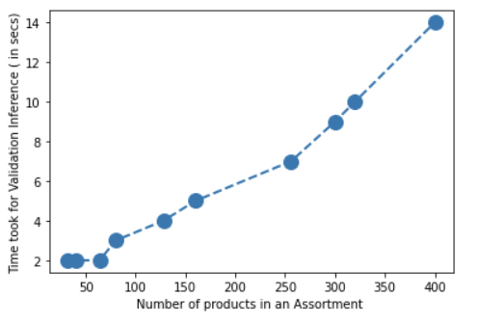
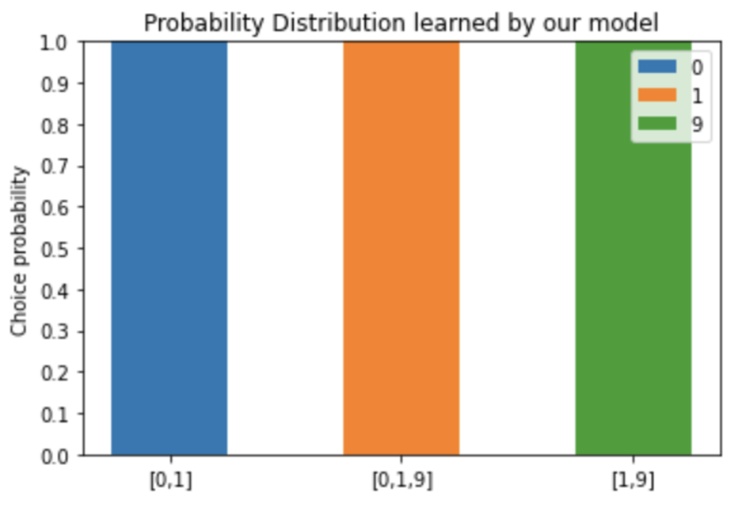
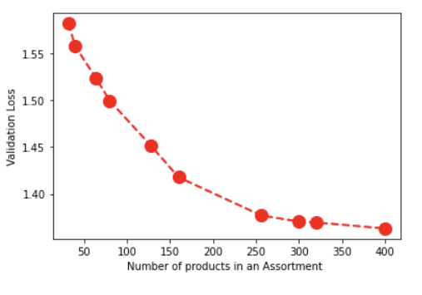
Pro-BERT: Product Assortment Contextual Embeddings for demand estimation.
Siddarth Reddy Desu
Mentor: Abhishek Bansal
Workflow
Embeddings of all products of the assortment are present while estimating the demand of one of the product.
So, the contextual embeddings of all products can be generated simultaneously, which are be used to estimate their respective demand.
Other major formulation in the model is to facilitate model to estimate the demand of all products in a single-go.
Dataset
Experiment to study the model effectiveness in terms of assortment learning-used MNIST dataset
Problem Statement
Dataset
90,000+ products
115 stores
93 weeks
For approx 2 years
2.5 million + transactions
To forecast the demand of a product in a retail store conditioned on an product assortment.
Product ‘s information is encoded into an embedding.
Incorporation of assortment into embedding
Using this embedding to estimate its demand
Training Conditions:
[0,1] ->
{ 0:0.9%,1:0.1%}
[0,1,9] ->
{ 0:0.1%,1:0.8%,2:0.1%}
[1,9] ->
{ 1:0.1%,9:0.9%}
One of the key formulation proposed In our model is a method for the efficient and effective incorporation of assortment information in the demand estimation .
The assortment information is passed to the embedding as a context to make it a contextual embedding.
The context is captured by self-attention layers as implemented in BERT.
Experiments & Results
Model Architecture
Experiment with mentioned products data to study the model efficiency and computational performance with assortments of different sizes.
Assortment
Training parameters:
Vocabulary size:92354
#self attention layers:4
#epochs:15
#loss function:MSE
Embedding size:64
Challenges
Product assortment information should be considered while estimating the demand of any product.
Proposed model should be generalizable and scalable to any dataset.
Model performance in terms of computational speed should be optimal even in the case of assortment with large sizes
Number of products in an assortment can be large and variable, the model must accommodate either of the scenarios.
Contextual Product Embedding
Number of self-attention layers in the models is intentionally designed to be multiple so as to capture several relationships across the products.
Model is capable of learning the embeddings for the task, provided unique product tokens and defined vocabulary.
Zero padding is used to deal with variable size assortments.
Self-Attention layer
Contextual Product Embedding
Embeddings of products in an assortment

